Slide 1

Text analysis of STEAM review dataset
Group members:
Cheng, Yifan
Lee, Yun Cheng (Henry)
Li, Edison
Li, Wenjun
Lin, Han Chun (Kevinac)

Slide 2

Dataset Background
Data source: Reviews of the game ”Red Dead Redemption 2 ” at the Steam Store
Scrap data using STEAM API by Python package steamreviews
Timeframe: Dec/5/2019 - Apr/12/2020
Review count: 21044 Reviews

Slide 3
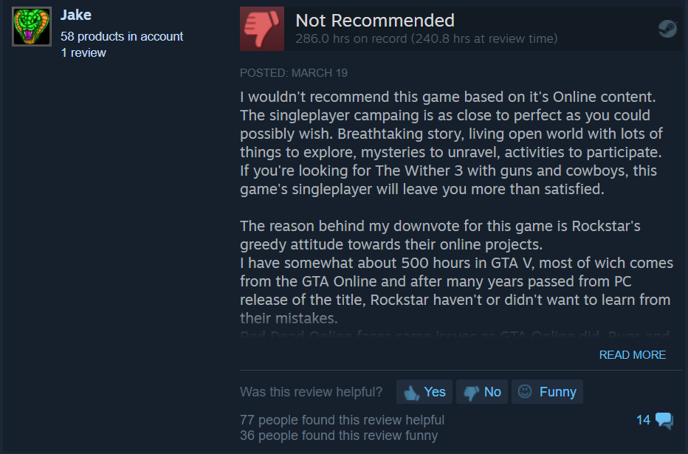
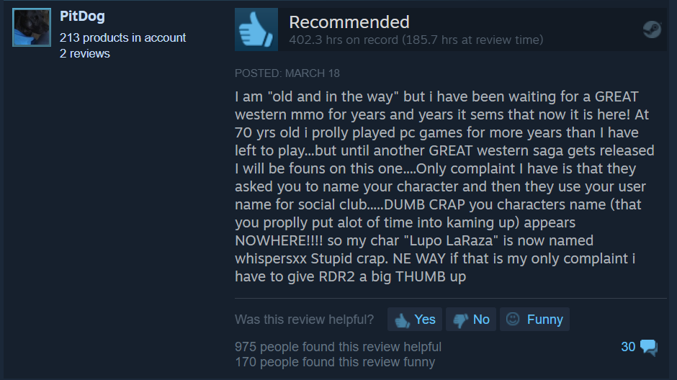
Dataset Content
recommendationid
author:
-steamid
-num_games_owned
-num_reviews
-playtime_forever
-playtime_last_two_weeks
-last_played
language
review
timestamp_created
timestamp_updated
voted_up (Recommand/not)
votes_up(Helpful)
votes_funny
comment_count
steam_purchase
received_for_free
written_during_early_access

Slide 4
Big Question
What are some of the aspects that gamers care about, in general?
What are some of the distinct aspects that different game groups care about?
Which topic have the most positive/negative reviews?
What are the common complaints?
What are the common bugs of the first month after launch?
What are the possible reasons why veteran gamers do not recommend the game?

Slide 5
App Idea
Web app (Tableau based dashboard) that is designed for game developers
Chose this game as proof of concept, but the app is expandable to include comparison between different games
This app will help game developers identify common complaint and improve the game they are developing

Slide 6
Analysis – Topic Modeling
Set number of topics = 4 (Coherence score 0.64 , topic = 5 : 0.61)
Gaming Experience (49.68%)
Story, graphic, Rockstar, character, experience, gameplay, bug, world, open_world, single_player
Bug & Issues (16.66%)
pc, crash, issue, problem, setting, steam, rockstar, performance, fix, run
Game Content & Design (25.26%)
horse, way, people, mission, character, story, gun, weapon, world, animal
Online Mode (8.4%)
mission, player, server, bug, rockstar, money, hacker, friend, camp, problem

Slide 7
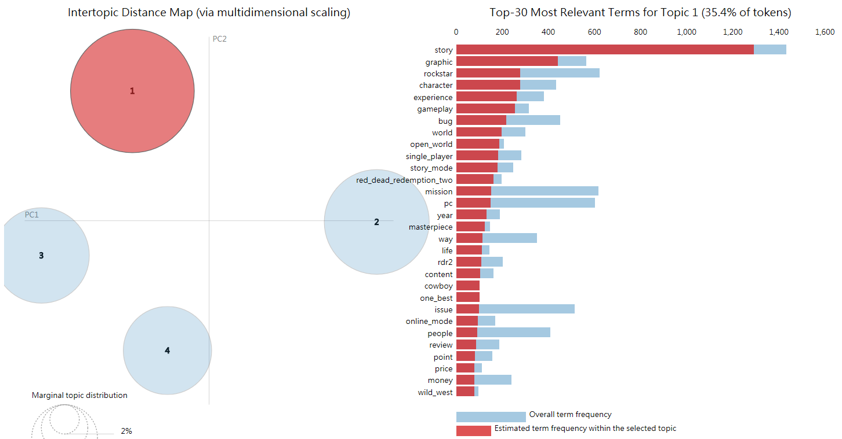
Analysis – Topic Modeling
https://yclee357.github.io/page1.html

Slide 8
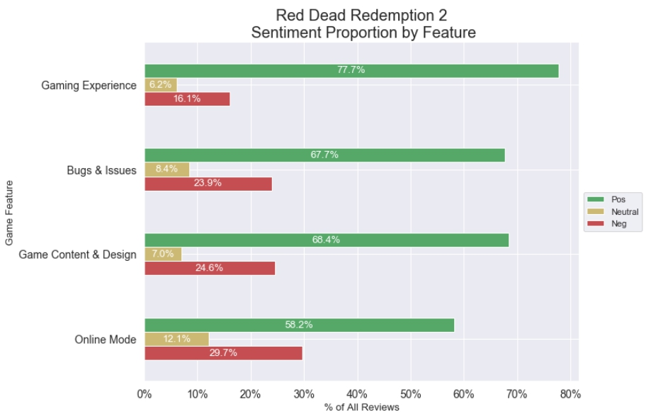
Sentiment Analysis by Feature
Overall experience is good
Online mode might have more bug than PC mode so received more negative review within that topic
Tableau Dashboard: https://yclee357.github.io/
Example: reviews with the highest and lowest compound sentiment score
Example: review that are hard to categorize
Notes:
Hater: ID3675

Slide 9
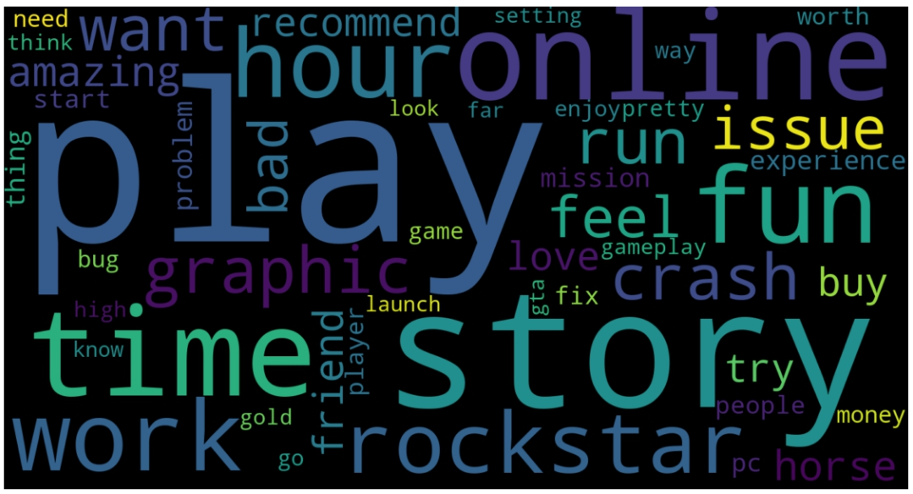
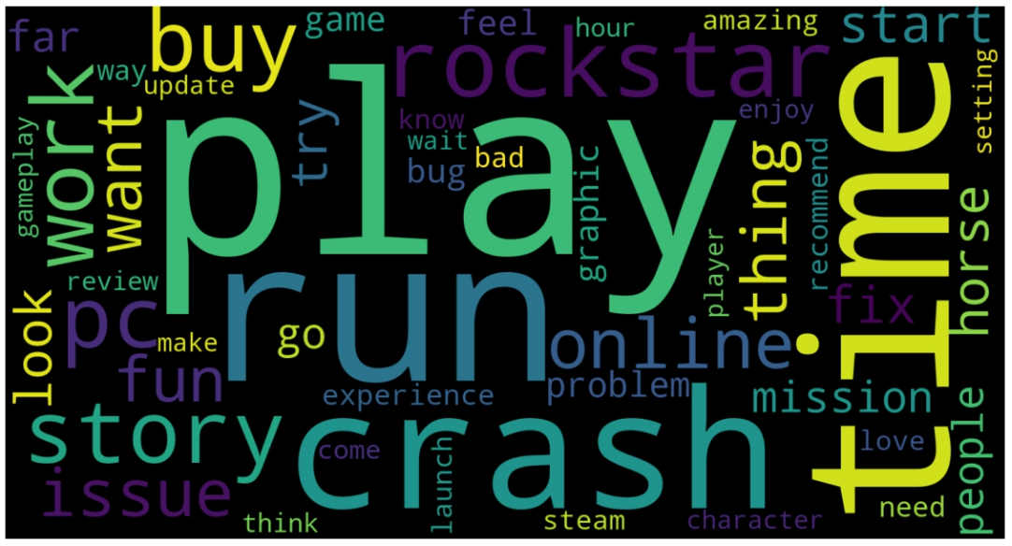
Analysis of different subsets
Free access player
First month after launch
 | Gaming Experience |  | Bug & Issues |  | Game Content & Design |  | Online Mode
 | Play time > 100 hr | Play time <= 100 hr | Play time > 100 hr | Play time < =100 hr | Play time > 100 hr | Play time < =100 hr | Play time > 100 hr | Play time < =100 hr
Positive | 77.1% | 66.1% | 66.3% | 68% | 65.9% | 58.6% | 63.2% | 67.6%
Neutral | 5.8% | 8.2% | 8.8% | 11.2% | 8.2% | 10.5% | 11.8% | 7.8%
Negative | 17% | 25.7% | 24.9 | 20.8% | 25.9% | 30.9% | 25.1% | 24.6%

Slide 10
Conclusions
Obstacle during our analysis
Subset with few review will have lower coherence score which is hard to build topic modeling (E.g. Free access subset with 267 review have coherence score 0.417)
Hard to categorize irony or sarcasm review to the appropriate topic
Next step
To improve the model, add additional stop words such as “Play”, “Rockstar”(Name of developer)
Train on larger dataset (Longer Time / More game)

Slide 11
Individual contribution
Cheng, Yifan – Subset analysis, Sentiment analysis
Lee, Yun Cheng (Henry) – Web scraping, Topic modeling , Sentiment analysis, Dashboard
Li, Edison – Subset analysis , Sentiment analysis
Li, Wenjun – Subset analysis , Sentiment analysis
Lin, Han Chun (Kevinac) – Topic modeling, Sentiment analysis , Power point

Slide 12
Thank You

